Slide 1
CS3391 Object Oriented Programming
Dr.D.Sivaganesan, Professor,
PSGiTech / CSE

Slide 2
PACKAGES
A java package is a group of similar types of classes, interfaces and sub-packages. Package in java can be categorized in two form,
1.built-in package 2.user-defined package.
There are many built-in packages
Syntax : import packagename;
import java.lang.*
import java.awt .*
import Java.swing .*
import java.net .* import java.io .* import java.util .* import java.sql .*
CS8392 Object Oriented Programming
Dr.D.Sivaganesan PSGiTech / CSE

Slide 3
import java.util.*; class input
{
public static void main(String args[])
{
int a,b,c;
Scanner s=new Scanner(System.in); System.out.println("1st value"); a=s.nextInt();
System.out.println("2nd value");
b=s.nextInt();
c=a+b;
System.out.println("addition result"+c);
}}
CS8392 Object Oriented Programming
Dr.D.Sivaganesan PSGiTech / CSE

Slide 4
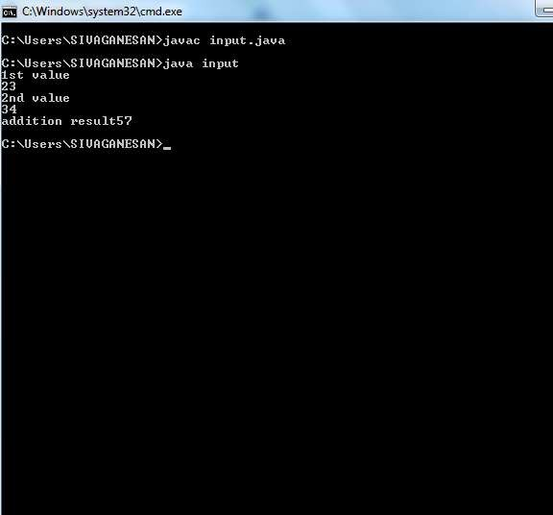
CS8392 Object Oriented Programming
Dr.D.Sivaganesan PSGiTech / CSE

Slide 5
import java.io.*;
import java.io.IOException; class datainput
{
public static void main(String args[]) throws IOException
{
int a,b,c;
DataInputStream s=new DataInputStream(System.in); System.out.println("1st value"); a=Integer.parseInt(s.readLine()); System.out.println("2nd value"); b=Integer.parseInt(s.readLine());
c=a+b;
System.out.println("addition result"+c);
}}
CS8392 Object Oriented Programming
Dr.D.Sivaganesan PSGiTech / CSE

Slide 6
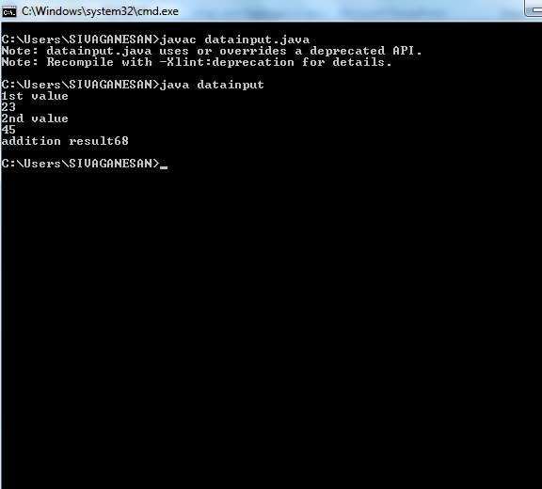
CS8392 Object Oriented Programming Dr.D.Sivaganesan PSGiTech / CSE
19

Slide 7
User Defined Package
To create a package include a package command as the first statement in a Java
source file. Any classes declared within that file will belong to the specified package.
The package statement defines a name space in which classes are stored.
If package statement is omitted, the class names are put into the default package,
which has no name.
Syntax:
package <fully qualified package name>;
Example : package pkg;
Here, pkg is the name of the package. For example, the following statement creates a package called MyPackage.
package MyPackage;
Java uses file system directories to store packages. For example, the .class files for any classes you declare to be part of MyPackage must be stored in a directory called MyPackage.
Accessing package : import packagename ex: import Mypackage

Slide 8
Steps to create and accessing package
1.Create java package source file with first statement as package pkgname;
2.Create a folder with package name
3.Compile java package file and copy the .class file into package folder.
4.Create a main java source file in order to use / access package with first statement as
import packagename.classname
5.Compile the main java file
6.Execute the main java file

Slide 9
Another ways to create package directory
1.Create java package source file with first statement as package pkgname;
2.Compile javac –d . sourceFile.java
-d indicates designation directory
. indicates where to store .class file . Here .class file
will be stored in the same directory
3. Create a main java source file in order to use / access
package with first statement as
import packagename.classname
4.Compile the main java file
5.Execute the main java file

Slide 10
//Java Package file expackage.java
package newp;
public class expackage
{
public int add(int a,int b)
{
return (a+b);
}
}

Slide 11
//Accessing Java Package file expackage.java
import newp.expackage;
class mainpack
{
public static void main(String args[])
{
expackage obj=new expackage();
System.out.println("Addition Result : "+obj.add(10,20));
}
}

Slide 12
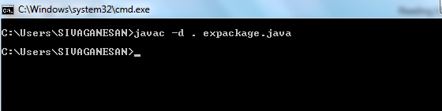
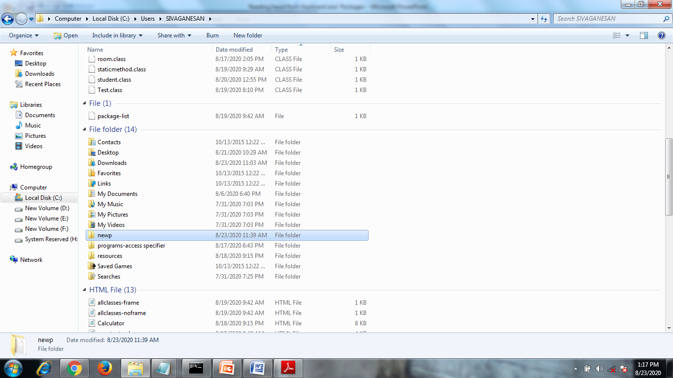

Slide 13


Slide 14
Thank you

